Slide 1

PRIVATE RESIDENTAL PROPERTY PRICES IN CCR
Data Analytics Capstone Project

Slide 2
TABLE OF CONTENTS
01
02
03
PROBLEM STATEMENT
DATA SOURCE & CLEANING
EXPLORATORY DATA ANALYSIS
04
05
06
MODELLING
DEPLOYMENT
Q & A

Slide 3

03.
01.
PROBLEM STATEMENT

Slide 4
Problem Statement
“Property prices in Singapore have been rising over the last few years. The objective of this project aims to construct a predictive model for the estimation of the intrinsic value of a property unit based on its respective characteristics and features, so as to aid investors in making more informed decisions.”
Scope - a focus on the private residential properties in the core central region (CCR) of Singapore, primarily in district 9, 10 and 11.
Target audience - Property investors and industry analysts who may find this relevant to their works and interests.

Slide 5
03.
02.
DATA SOURCE & CLEANING

Slide 6
Data Source
Urban Redevelopment Authority (URA) website:
www.ura.gov.sg
- Private Residential Property Transactions dataset
- Private Residential Rental Contracts dataset
(data range: Jan-2018 to Mar-2023)
PropertyGuru website:
www.propertyguru.com.sg
- Property listings
- Property projects details

Slide 7
Data Cleaning
Dropped null values
Removed columns irrelevant to analysis.
Standardize all area measurements to sqft.
Adjust date columns from “string” to “date” data type.
Adjust all price and area data from “string” to “float” data type.
Inserted a calculated column “rental psf” (rental divide by unit area) in the rental dataset to have a standard measure across units.
Added a “Proj ID” column to have a unique identifier for each individual project.
Group data by projects and created a table to collect features of respective projects including developer, site area, leasehold, TOP date, property type, distance to mrt etc.

Slide 8
03.
03.
EXPLORATORY DATA ANALYSIS

Slide 9
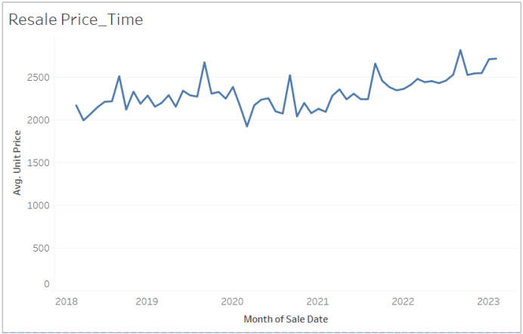
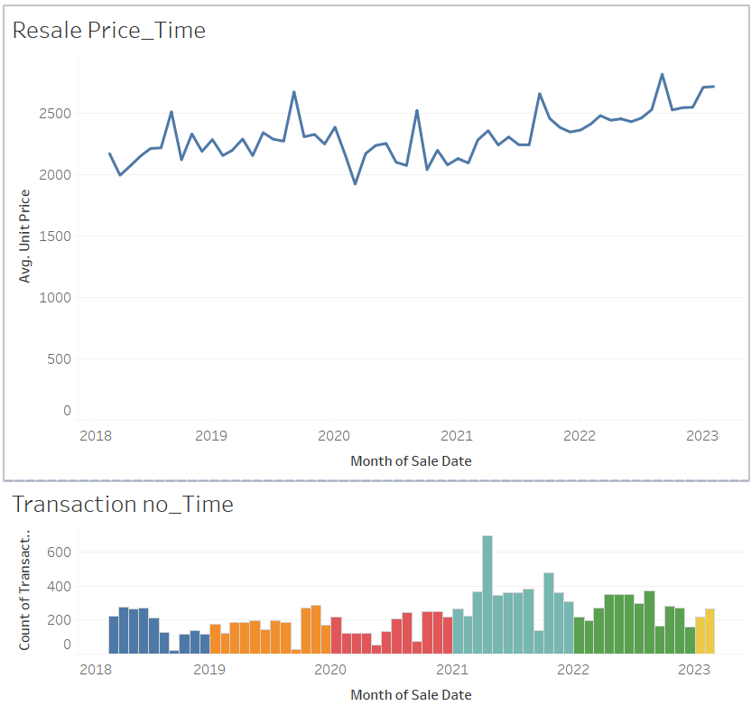
Resale Prices volatile but on a general uptrend

Slide 10
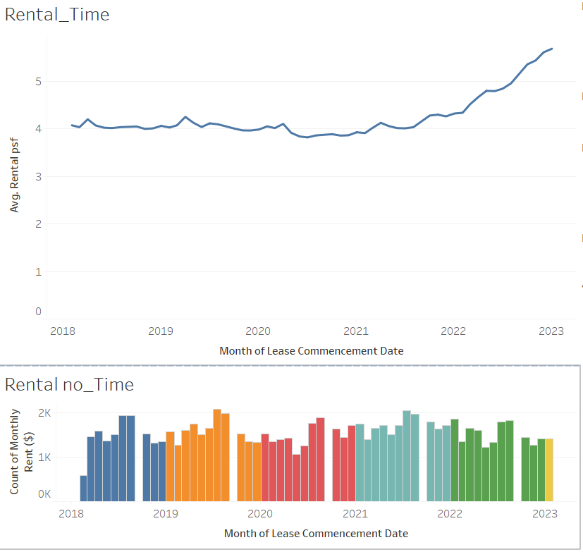
Rental Rates on steady climb from mid-2021

Slide 11
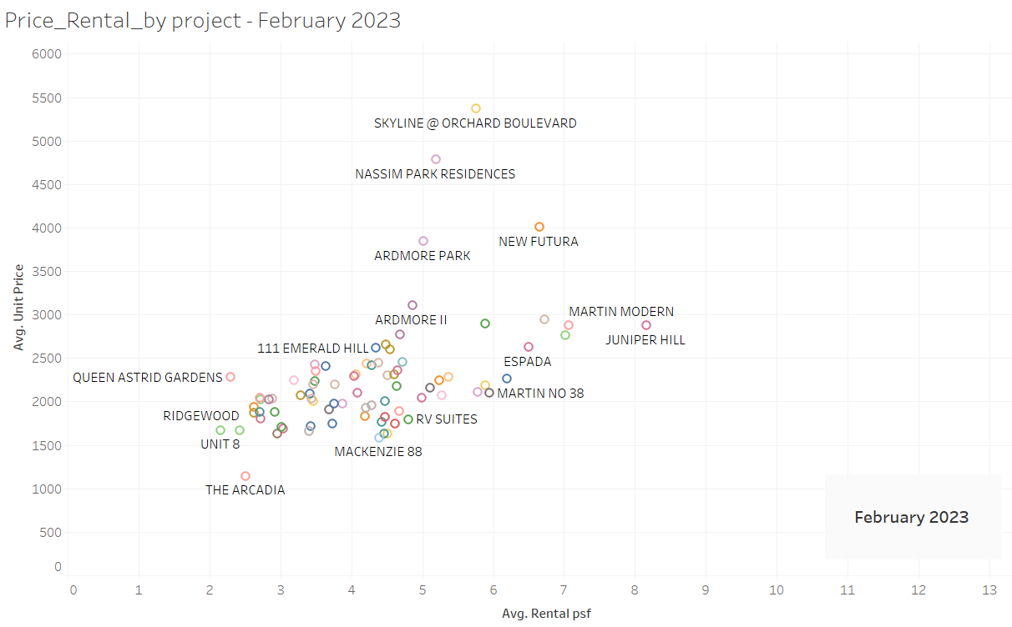
Prices and Rental by Projects - Tableau Animation

Slide 12
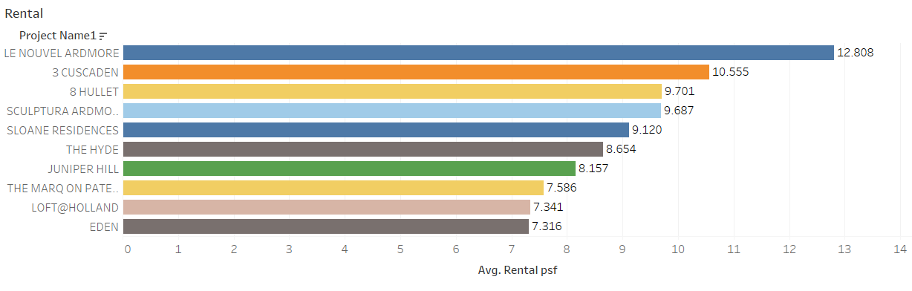
Top 10 Projects By Rental

Slide 13
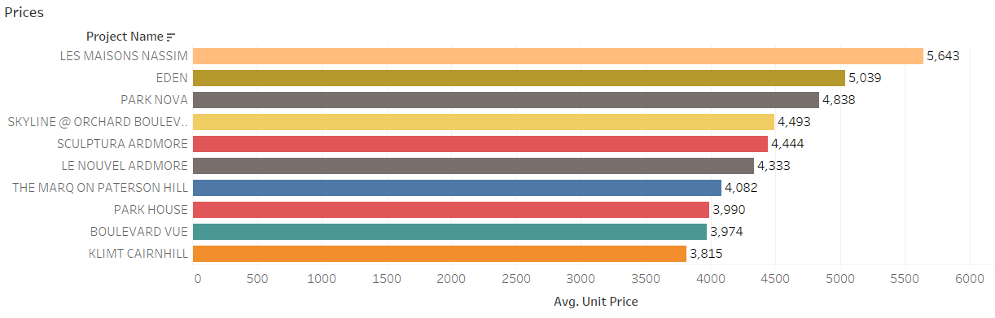
Top 10 Projects By Resale Prices

Slide 14
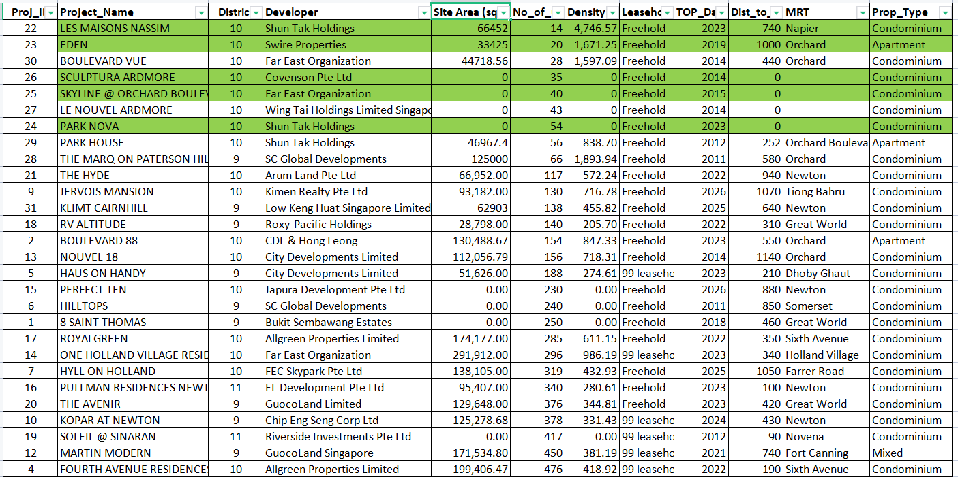
Top Projects Features

Slide 15
03.
04.
MODELLING

Slide 16
Modelling - Preparing Data
Narrowed the scope -
Limit to just projects in the Top 20 by volume and Top 10 by prices that have complete data.
Filtered to total 23 projects with 4,718 transactions for analysis
Drop outliners
Dummify Categorical Features -
PropertyType: Apartment = 1 ; Condominium = 2
Tenure: 99-leasehold = 1 ; Freehold = 2

Slide 17
Different Models
Model | Description | Remarks
Benchmark model | Y = y-mean | Taking mean of y as predicted y value
Simple Linear Regression Model | Y = mX + C | Where Y is dependent variable “Unit_Price”, X is independent variable “Area”, m is coefficient, C is y-intercept
Multi-Factor Linear Regression Model | Y = m1(X1) + m2(X2) + … + m5X5 + C | Where Features X are [Area, PropertyType, Tenure, Unit_Age, Dist_to_mrt]

Slide 18
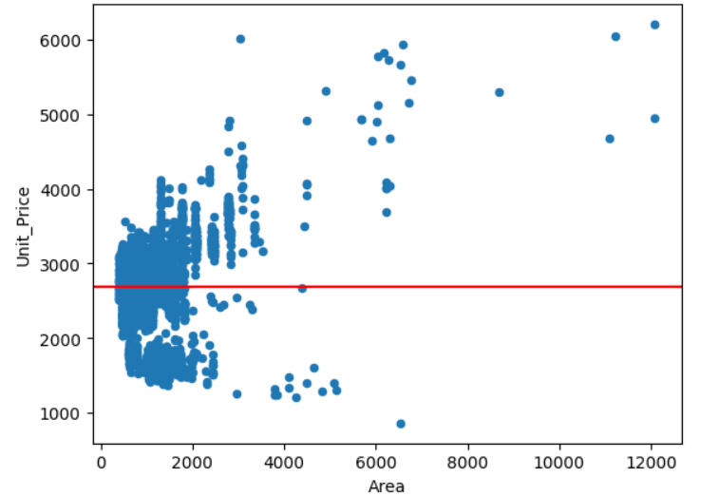

Modelling - Benchmark Model

Slide 19
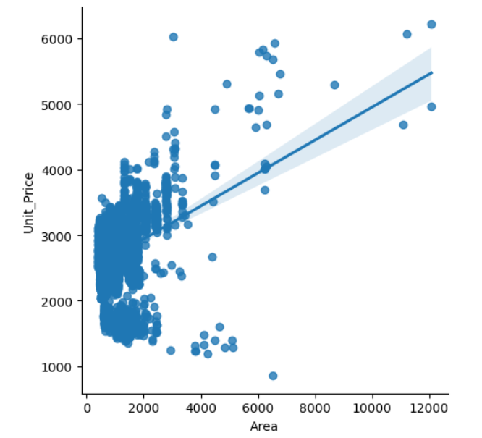

Modelling - Simple Linear Regression Model

Slide 20
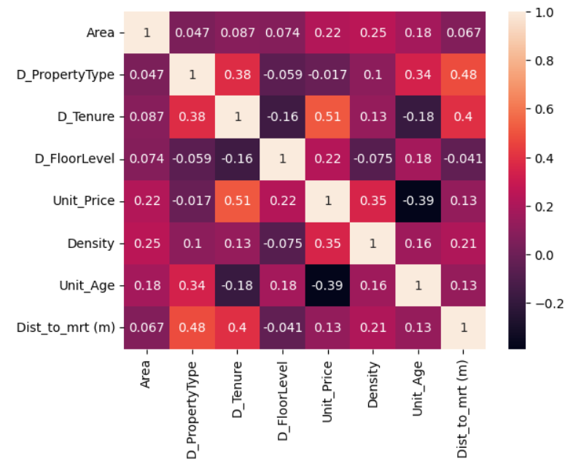
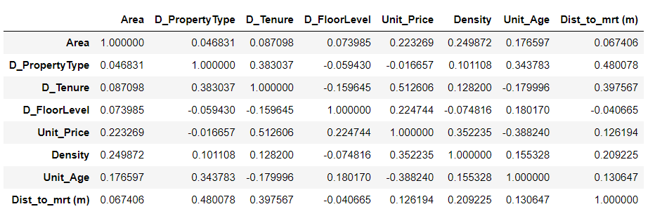
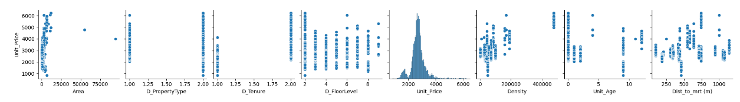
Modelling - Correlation Analysis

Slide 21
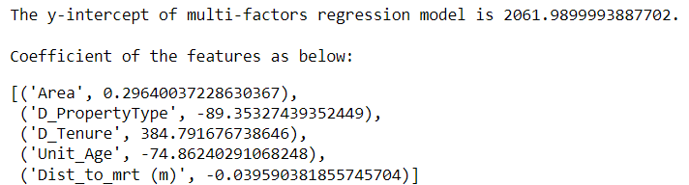

Modelling - Multi-Factor Linear Regression Model

Slide 22
Modelling - Results
Model | Description | Remarks | R-square | RMSE as percentage of y-mean
Benchmark model | Y = 2,691.04 | Taking mean of y as predicted y value | NA | 17.59%
Simple Linear Regression Model | Y = (0.2367)X + 2449.2244 | Where Y is “Unit_Price” in psf, X is “Area” in sqft | 0.1306 | 15.70%
Multi-Factor Linear Regression Model | Y = (0.2964)X1 + (-89.3533)X2 + (384.7917)X3 + (-74.8624)X4 + (-0.0396)X5 + 2061.99 | Where X1 = Area in sqft, X2 = Property Type (1=apartment; 2=condo), X3 = Tenure (1=99-leasehold; 2= Freehold), X4 = Unit Age in year, X5 = Distance to mrt in meters | 0.5475 | 11.53%

Slide 23
03.
05.
DEPLOYMENT

Slide 24
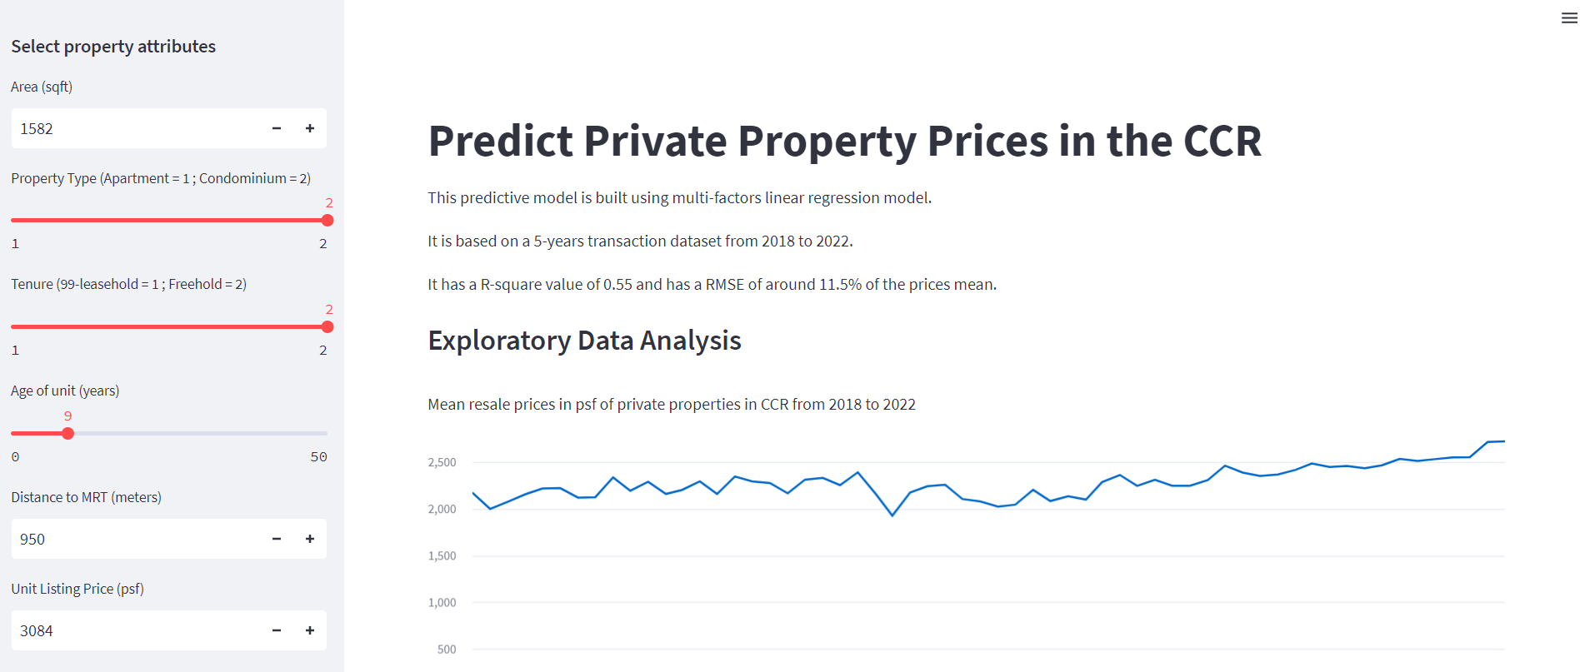
Deployment
https://ngchekwee-capstone-private-property-prop-app-ph450p.streamlit.app/

Slide 25
03.
06.
QUESTIONS & ANSWERS

Slide 26


